Slide 1
CLASS 05: BUILD PROGRAM LOGIC(03)
Intro iterative statement, for , while statement, nested loops

Slide 2
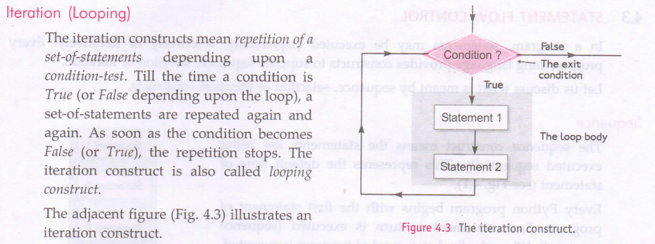

Slide 3
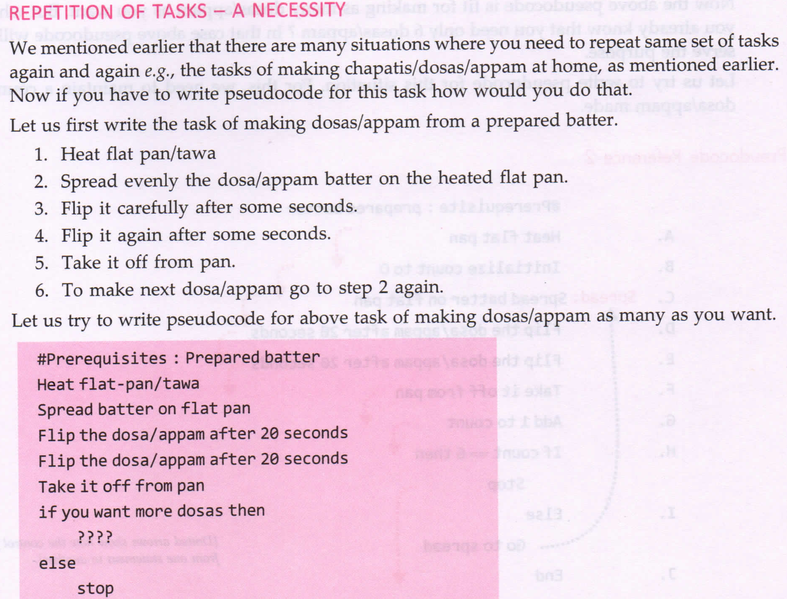

Slide 4
range() Function
Generates a list which is a special sequence type.
Syntax : range(<lower limit>,<upper limit>)
both limits to be integers.
range(a,b) will produce a list having values a, a+1, a+2 ... b-1
For eg.
range(0,5) will produce [0,1,2,3,4] default step size=1
range(5,0,-1) will produce [5,4,3,2,1] step size=-1
For different step size:
range(l, u, s) will produce list having values l, l+s, l+2s, l+3s .... <= u-1
Another format : range(n)

Slide 5
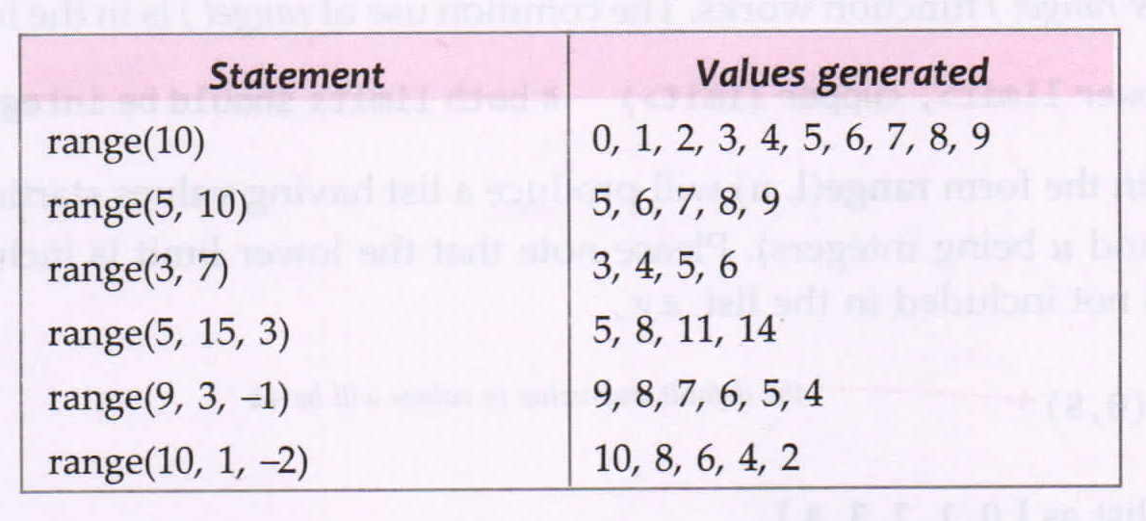

Slide 6
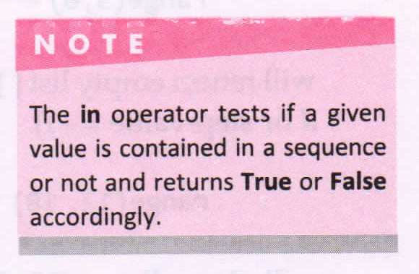
Use of in and not in operators

Slide 7
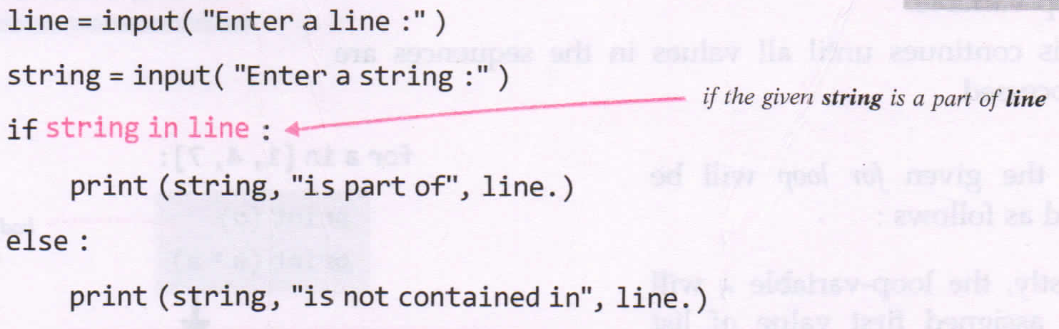
Check for this... !!!

Slide 8
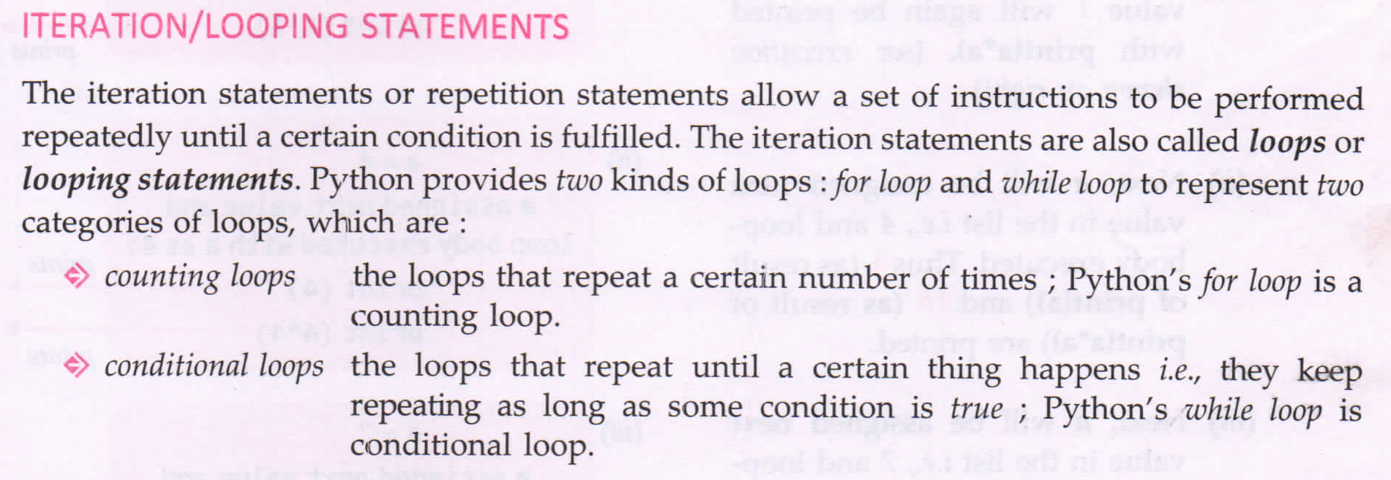

Slide 9
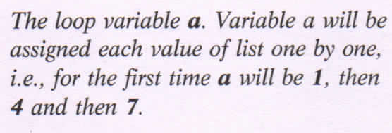
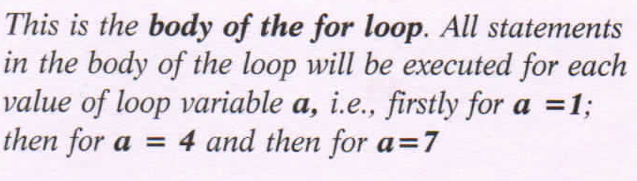
for loop
Process items in a sequence.
Syntax: for <variable> in <sequence>:
Eg:
for a in [1,4,7]:
print(a)
print(a*a)

Slide 10
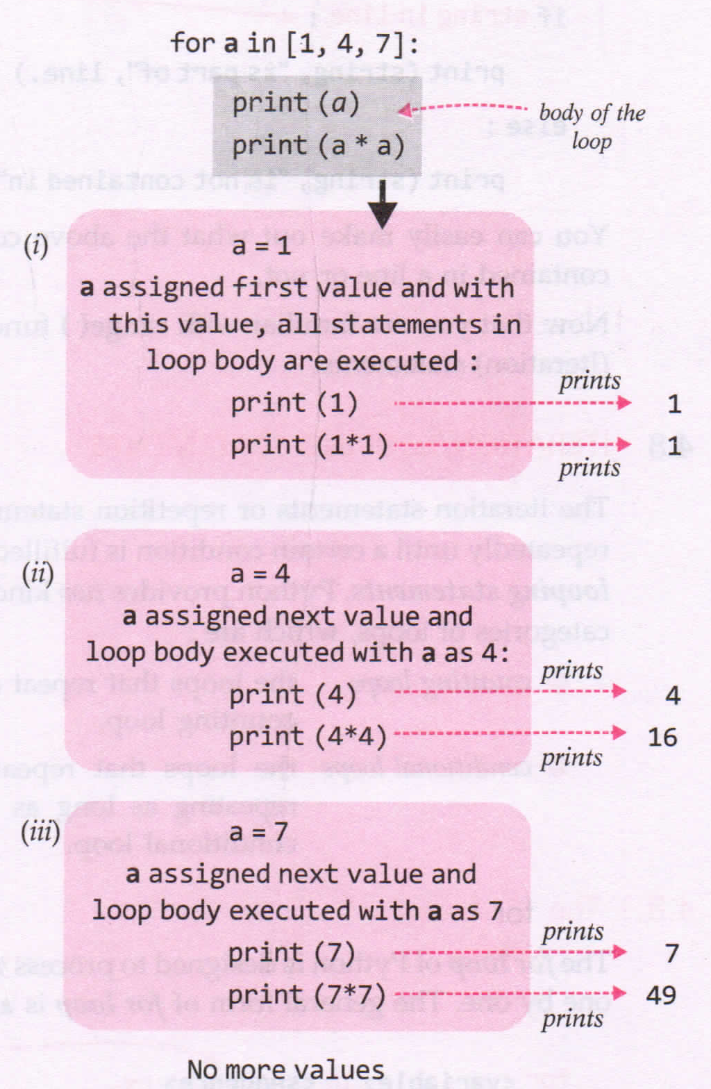

Slide 11
Programs
P1: Program to print table of number 5.
P2: Program to print table of a user input number.
P3: Program to print sum of ‘n’ Natural Numbers.

Slide 12
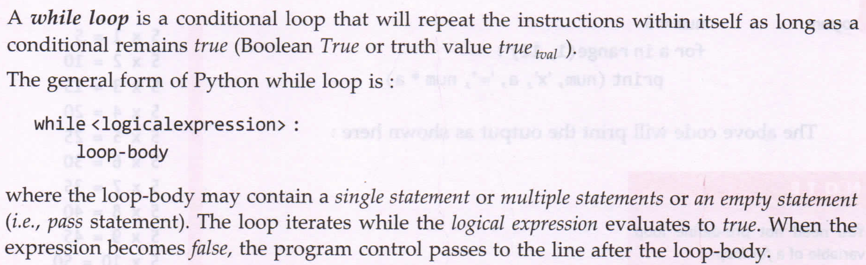
while loop

Slide 13
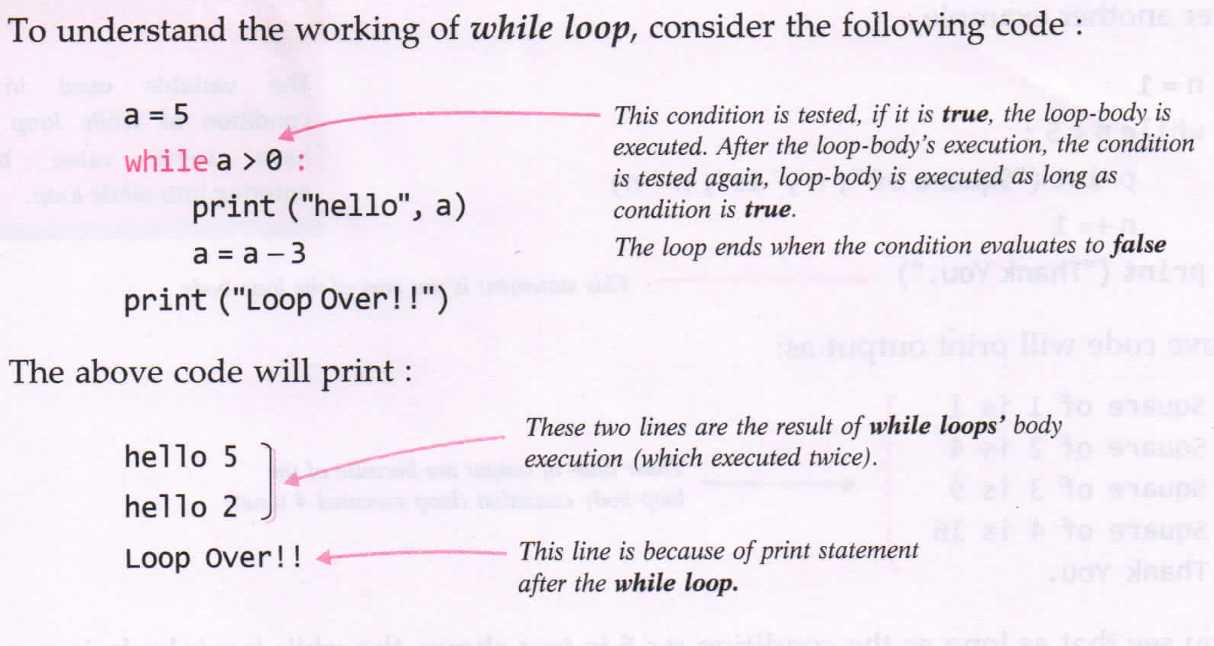

Slide 14
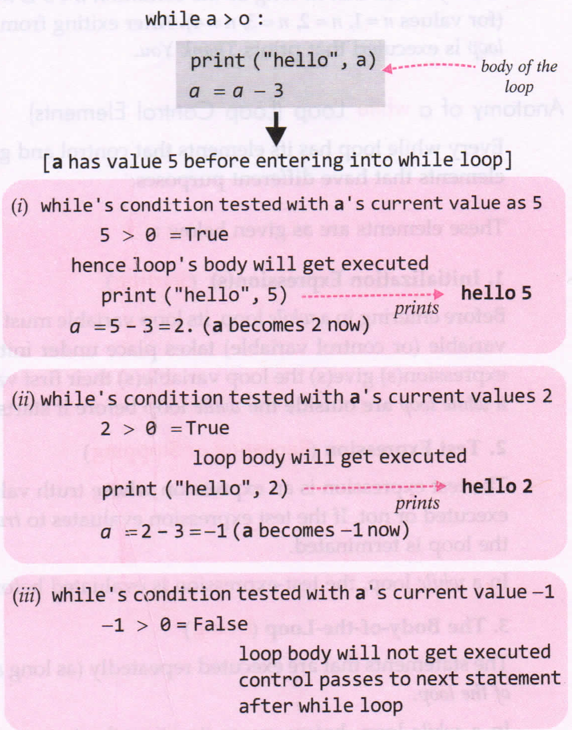

Slide 15
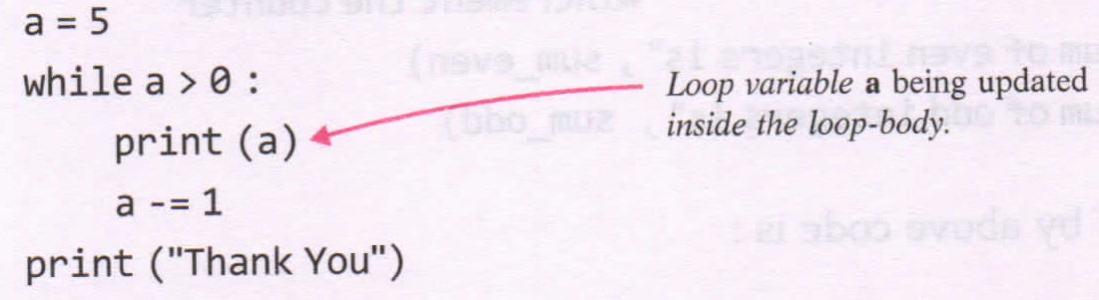
Check it out!!
Predict the output?
5
4
3
2
1
Thank You

Slide 16
Programs...
Do programs of for loop using while loop
P1: Program to calculate the factorial of a number.
Factorial of 5 = 5x4x3x2x1 = 120
P2: Program to calculate and print the sum of even and odd integers of first n natural numbers.
Example:
N=5
Even number= 2,4 (6)
Odd Numbers = 1,3,5 (9)

Slide 17

    







